Slide 1

Differences between relational & non-relational databases.

Slide 2

CONTENTS
DEFINITIONS
STRUCTURE
CHARACTERISTICS
USES
PROS & CONS
SUMMARY

Slide 3
DEFINITIONS
For Context; what is a database?
A Database is an organized collection that is stored and managed so it can be easily accessed, modified, and retrieved. A good analogy for a database is a well-kept and organized LIBRARY.
There are two types of database: Relational (RDBMS) and Non-relational databases(NoSQL).
Relational Database organizes data into TABLES (relations) with rows & columns. Each table stores a specific type of data, and tables are connected by relationships using KEYS.
Non-Relational databases store data in non-tabular formats such as documents, key-value pairs or graphs.
FUNDAMENTALLY, THE KEY DIFFERENCE BETWEEN THE TWO TYPES OF DATABASES BOILS DOWN TO THE PRESENCE AND ABSENCE OF TABLES IN ONE OR THE OTHER, AS WELL AS THE QUERY LANGUAGE USED TO STRUCTURE THEM.

Slide 4
CHARACTERISTIC DIFFERENCES
RELATIONAL DATABASE (RDBMS)
Scales vertically (upgrading hardware)
Ideal for relationships between data
Strict ACID compliance (Atomicity, Consistency, Isolation, Durability). This ensures that transactions are processed reliably and the data remains consistent even in the event of system failures.
NON-RELATIONAL DATABASE
Scales horizontally (adds more servers) suitable for distributed systems
Can handle large amounts of unstructured or semi-structured data
Generally, follow the BASE model (Basically Available, Soft state, Eventually consistent), which allows for eventual consistency rather than immediate consistency. This makes them suitable for systems where availability and partition tolerance (keeping the system running even with network failures) are more important than strict consistency.

Slide 5
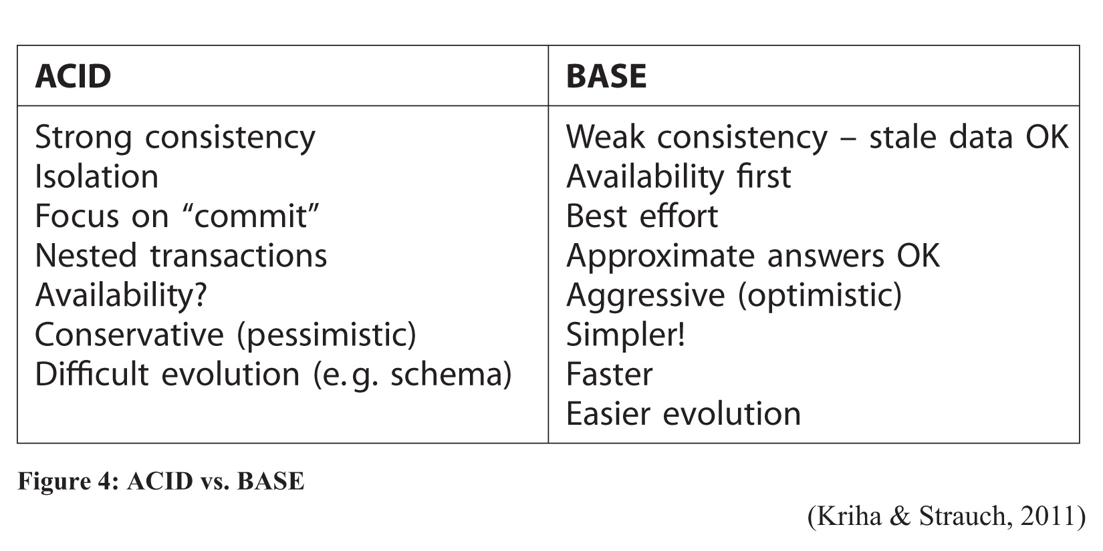
ACID vs base

Slide 6
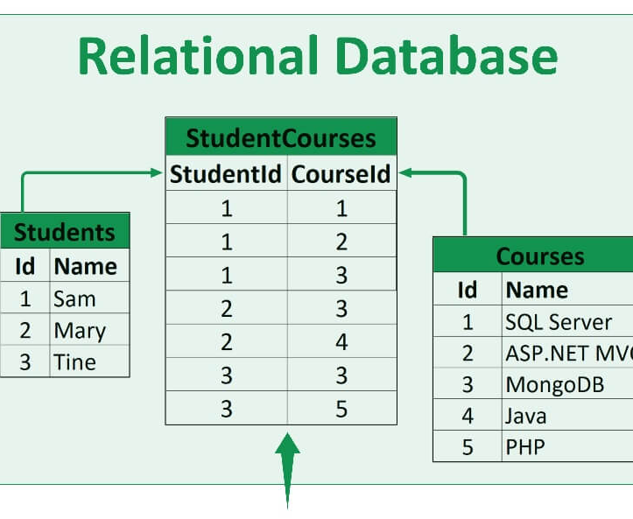
STRUCTURAL DIFFERENCES
Highly Structured with defined schemas
Data is stored in tables with rows & columns; with each row representing a record with a unique ID called KEYS, and columns representing a specific field.
Tables must adhere to the schema, that is, changes requires update across related tables.
Uses Structured Query Language (SQL) for defining, querying & managing data.
The image above shows a relational database which sores data in TABLES with rows and tables, using Structured Query Language(SQL) to manage and query data. These Tables are connected through relationships.
In the image above, Student ID and Course ID are the KEYS, and the relationship between these tables are that students take the courses.

Slide 7
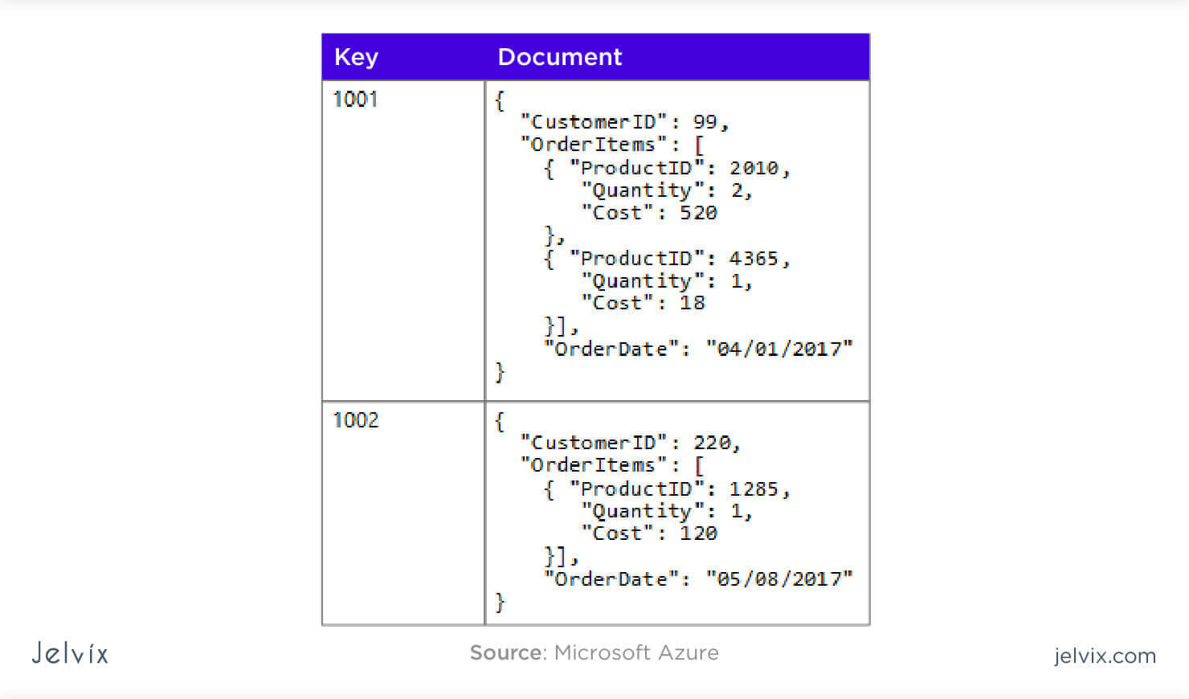
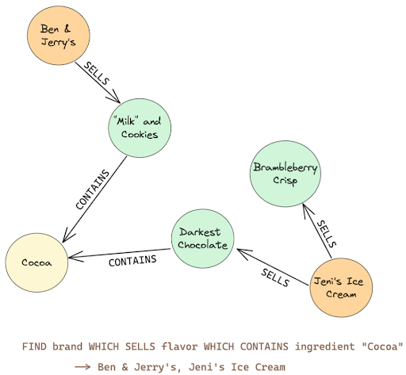
STRUCTURAL DIFFERENCES
They have flexible structure unlike the relational database; data could be stored as JSON, XML(Documents), graphs, or key-value pairs.
Each entry may have a different structure, and fields can be added without affecting others.
Uses different query methods depending on the type of database.
The image above shows a type of NON-RELATIONAL database namely a document database.

Slide 8
USE CASES
RELATIONAL DATABASES:
Best for structured data and use cases where relationships between data are important (e.g., customer data, financial systems, and any system where data integrity is critical).
Example: A banking system that needs to store transaction details, customer info, and account balances, ensuring all data is consistent.
NON-RELATIONAL DATABASES:
Best for unstructured or semi-structured data, large datasets, and situations requiring fast access to large amounts of data or when data structure can vary (e.g., social media platforms, real-time analytics, IoT systems).
Example: A social media app where user profiles, posts, comments, and likes are stored in a more flexible way since different users might have varying amounts of data.

Slide 9
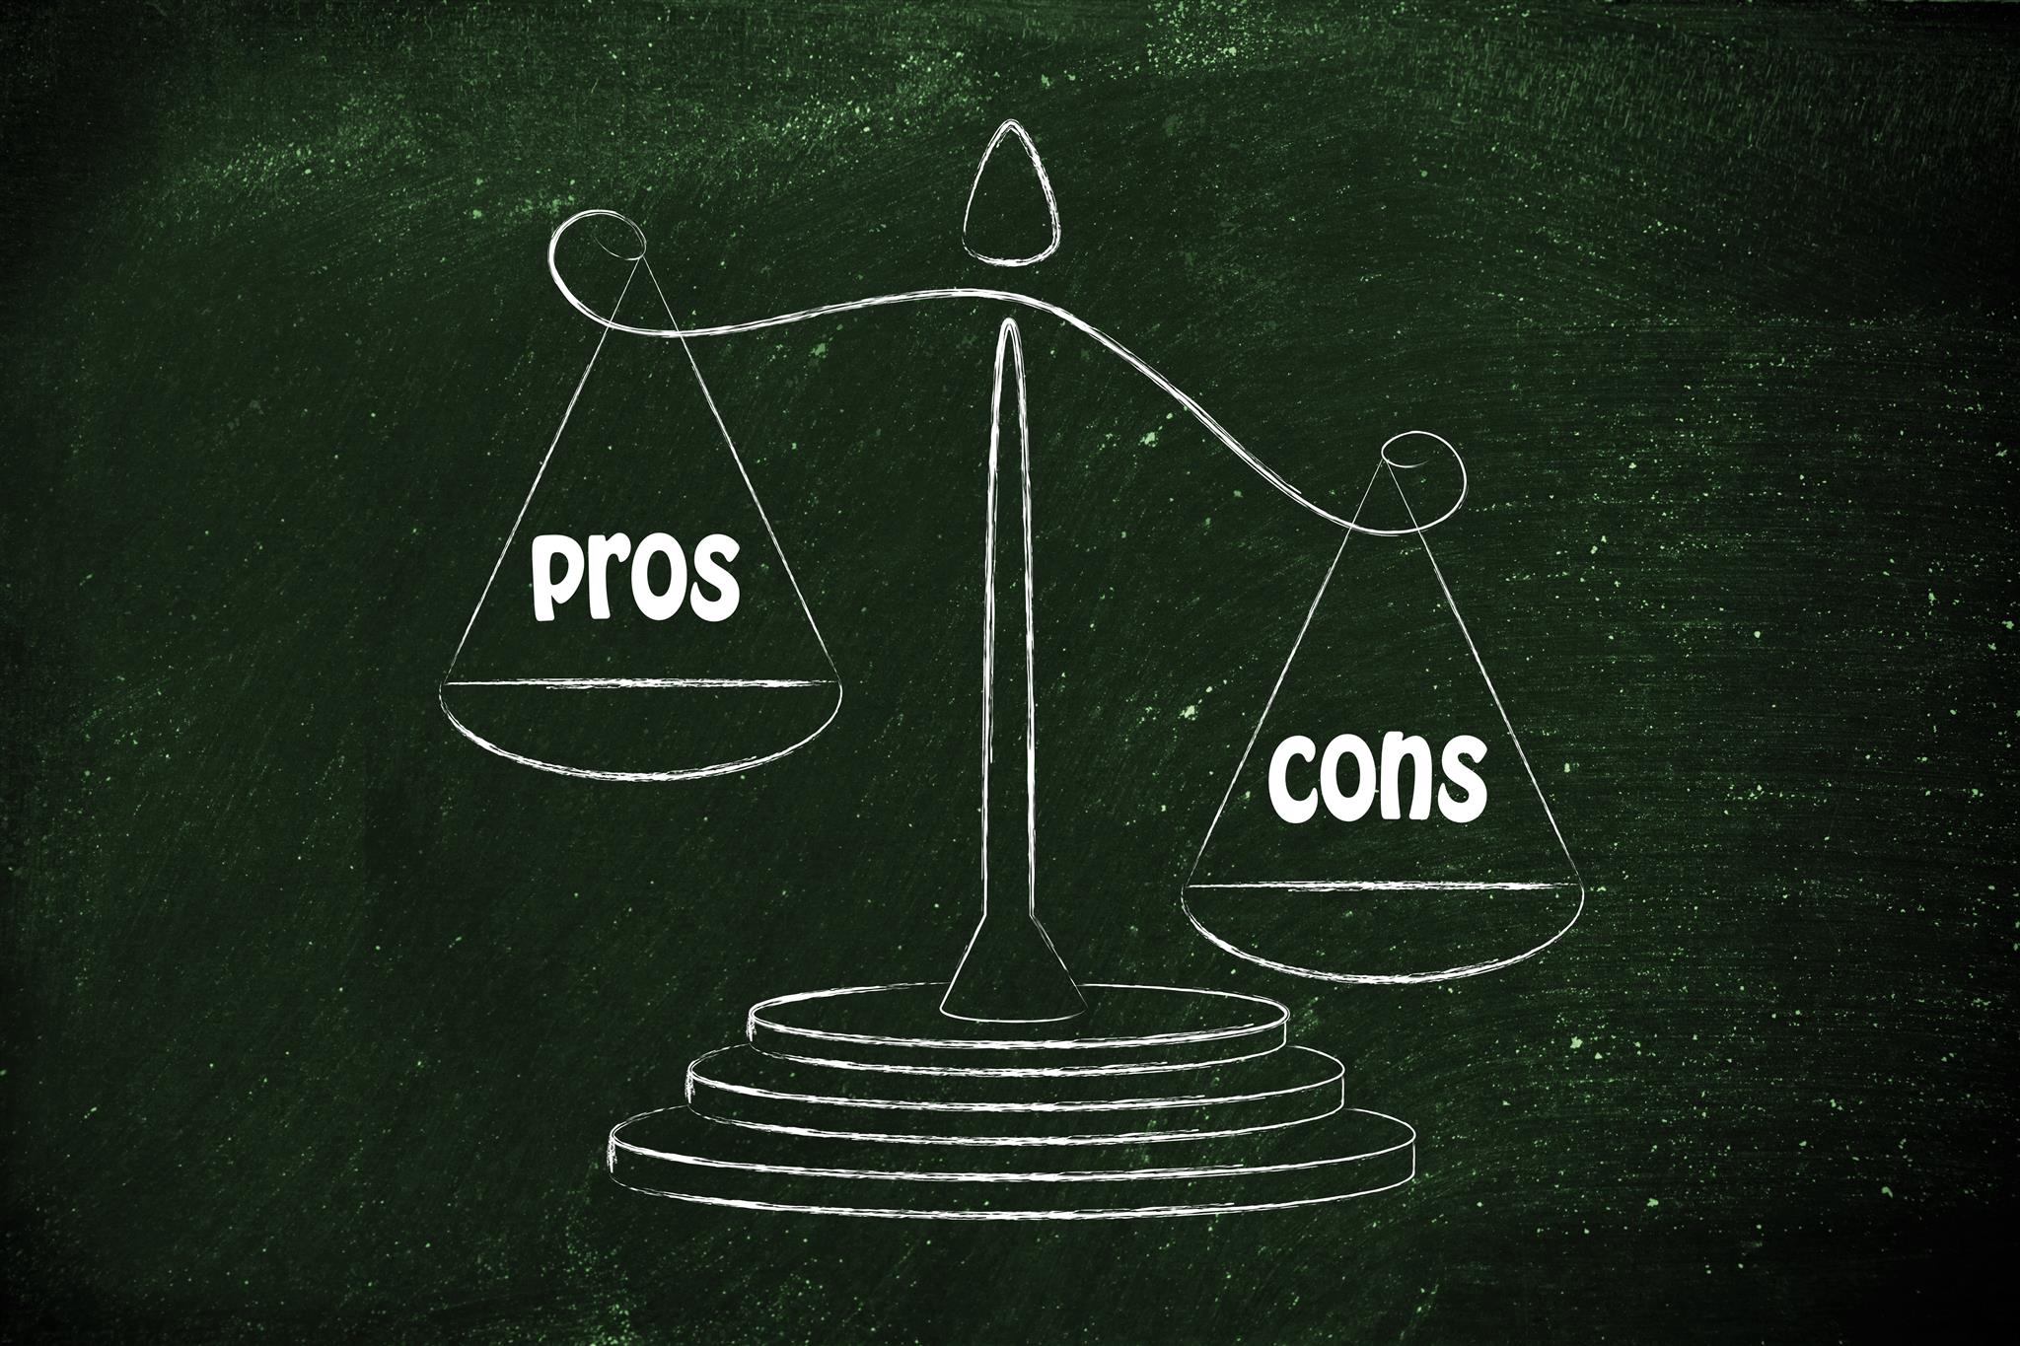

Slide 10
RELATIONAL DATABASE | NON-RELATIONAL DATABASE
Fixed schema (tables, rows, and columns). Data is structured. | Flexible schema (documents, key-value, graphs, etc.). Data can be unstructured or semi-structured.
Typically scales vertically (upgrading server capacity). | Scales horizontally (adding more servers/nodes), ideal for distributed systems.
Less flexible. Schema changes can be difficult and time-consuming. | Highly flexible, allowing dynamic changes to data structures without downtime.
Excellent for managing complex relationships between data using foreign keys. | Limited support for complex relationships, though some NoSQL types (e.g., graph databases) handle relationships well.
Strong consistency with ACID compliance (Atomicity, Consistency, Isolation, Durability). | Follows BASE model (Basically Available, Soft state, Eventually consistent), focusing on availability over consistency.

Slide 11
RELATIONAL DATABASE | NON-RELATIONAL DATABASE
Uses SQL (Structured Query Language), a powerful, standard language for querying. | No standardized query language; varies depending on the database type (e.g., MongoDB uses a JSON-like query language).
Strong data integrity, with schema enforcement and constraints (primary/foreign keys). | Less rigid data integrity; allows flexible, schema-less data, making it easier to handle changing data requirements.
Mature backup and recovery processes with built-in support for data integrity. | Backup and recovery can be more complex, especially in distributed setups.
High performance for smaller datasets and structured data with complex queries. | May not perform as well on small, highly structured datasets compared to RDBMS.
Can struggle with massive datasets, requiring more expensive vertical scaling. | Excellent for handling large, distributed datasets, often faster in high-traffic environments due to horizontal scalability.

Slide 12
SUMMARY
ASPECT | RELATIONAL DATABASE (RDBMS) | NON-RELATIONAL DATABASE (NoSQL)
STRUCTURE | TABLES with rows & columns | DOCUMENTS, GRAPHS, KEY-VALUE PAIRS etc.
RELATIONSHIPS | Strong relationships using FOREIGN KEYS | Limited relationships or stored in embedded documents
SCHEMA | Fixed Schema | Flexible, Dynamic or Schema-less
QUERY LANGUAGE | SQL (structured query language) | VARIES
SCALABILITY | VERTICAL scaling(add more resources) | HORIZONTAL scaling(add more servers)
DATA CONSISTENCY | ACID-compliant (SRONG CONSISTENCY) | Mostly BASE-compliant (EVENTUAL CONSISTENCY)
USE CASES | BANKING, e-commerce, inventory management | Social media, IoT, Big Data analytics.

